Slide 1
Analyzing IPL Data
Krishna Solanki
Notes:
ID=d924773e-9a16-4d6d-9803-8cb819e99682 Recipe=text_billboard Type=TextOnly Variant=0 FamilyID=AccentBoxWalbaum_Zero

Slide 2
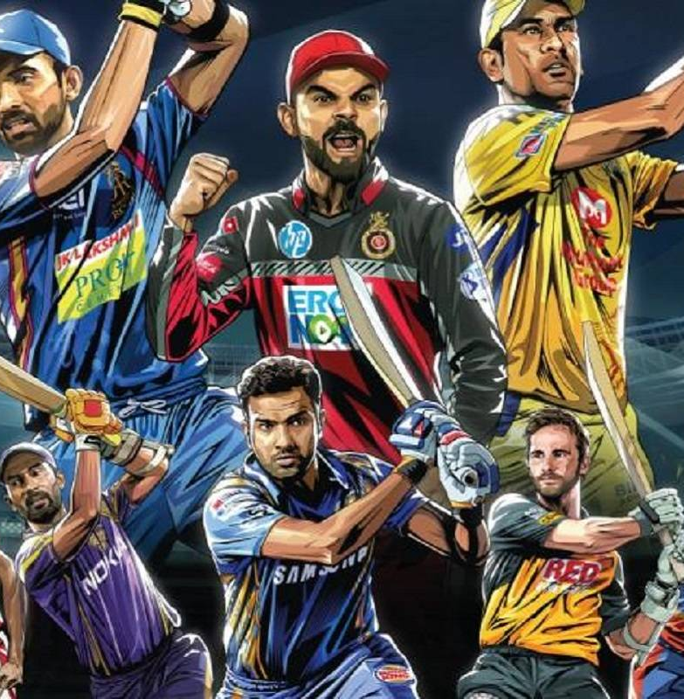
Agenda
Introduction
Data acquisition, cleaning and analyzing
Result
Recommendation
Conclusion

Slide 3
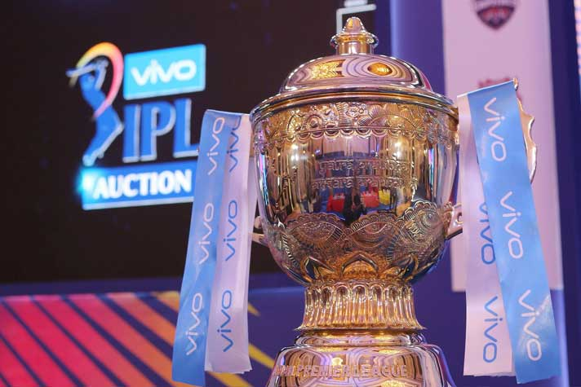
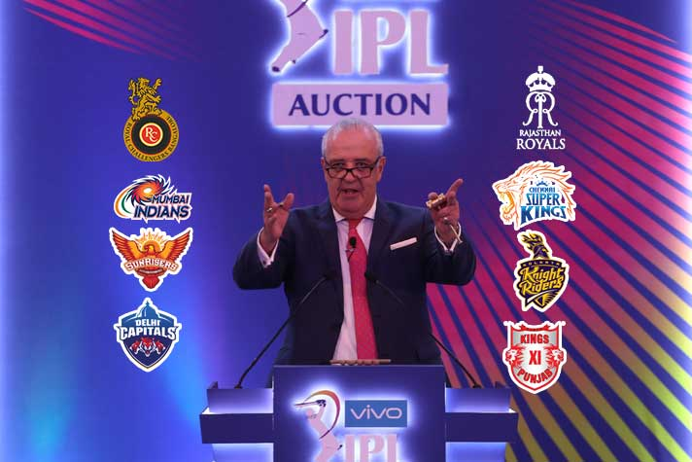
Introduction
One of the best cricket league around the globe.
Improve player performance and bring out their weakness.
Analysis for auction and put a bid on new player.

Slide 4
Data acquisition, cleaning and analyzing
IPL dataset captured from Kaggle. This dataset contains IPL cricket match data between 2008 and 2016.
deliveries.csv is the ball-by-ball data of all the IPL matches including data of batting team, batsman, bowler, non-striker, runs scored, etc.
matches.csv contains details related to the match such as location, contesting teams, umpires, results, etc.
We will get geo-coordinate of city using geocoder tool.

Slide 5
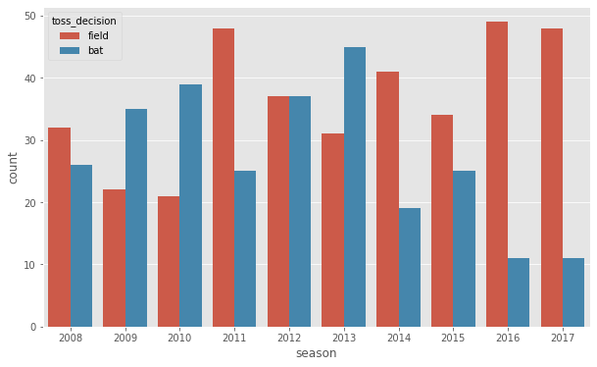
Toss Decision
The decision for batting or fielding varies largely across the seasons. In some seasons, the probability that toss winners opt for batting is high, while it is not the case in other seasons. In 2016 though, most toss winners opted for batting.

Slide 6
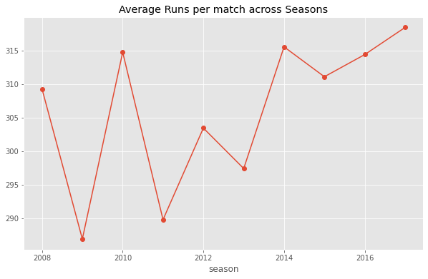
Average runs per match across season
Graph represent the average runs per match by both teams combined. We can clearly see hiking in runs in 2010 compare to 2009. And it’s highest in 2016.

Slide 7
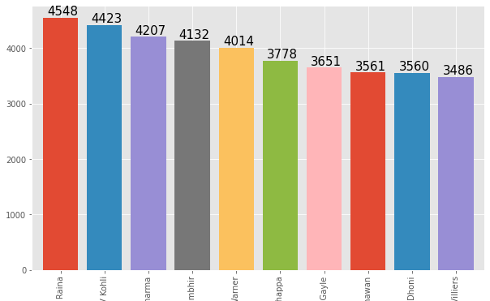
Top batsman
In the top 10 batsman of IPL Suresh Raina is on top followed by Virat Kohli and RG Sharma is on 3rd in the list.

Slide 8
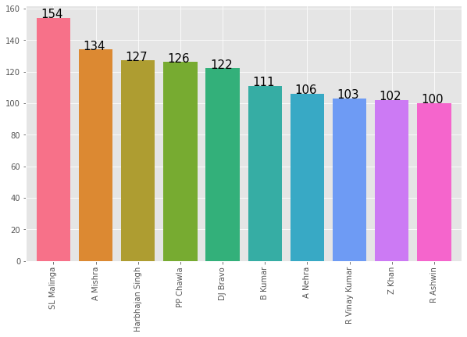
Top bowler
In the top 10 IPL bowler then SL Malinga on first number with 154 wickets. Thanks to his unpredictable bowling action. Remaining bowlers in the graph doesn’t have much wicket margin.

Slide 9
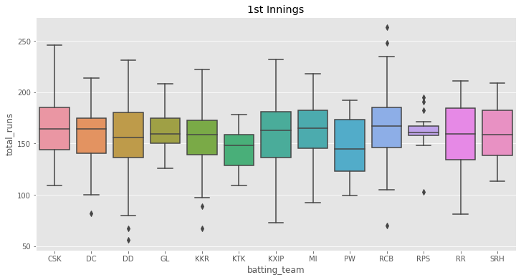
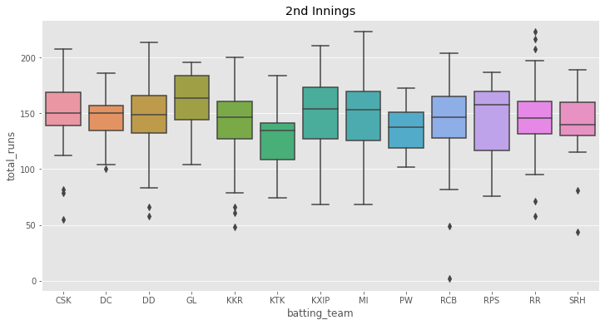
Score distributions for teams by Innings
1st boxplot CSK is the best scorer when it comes to batting first and as per 2nd boxplot it shows MI is looking good when comes to 2nd batting.
In 2nd boxplot we see a point near 0 which may seem to be outlier. But it is so because the match was disrupted.

Slide 10
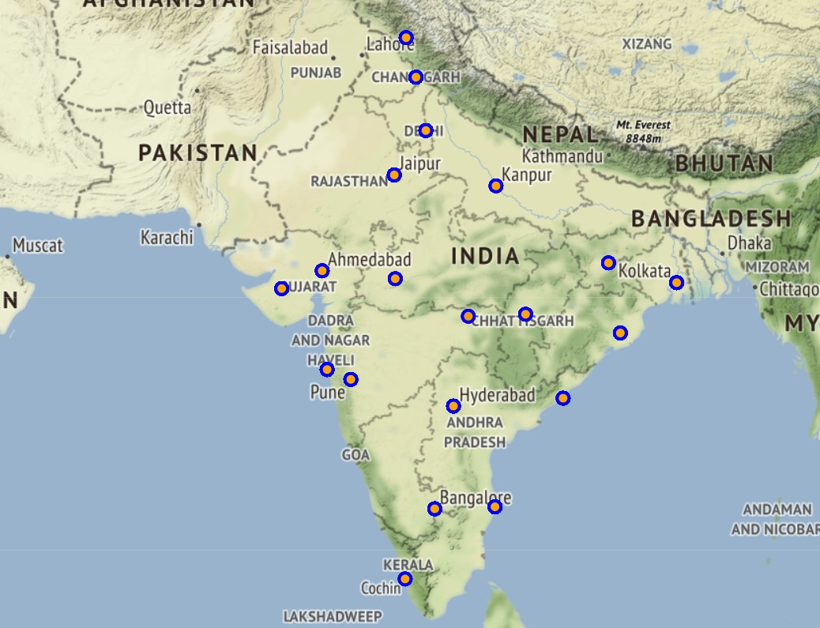
Match venue
Venues of the match is shown in below map in blue and orange circle. We plotted the map using folium and using “Stamen Terrain” tiles. When you click on the circle it shows the name of stadium where match has been played.

Slide 11
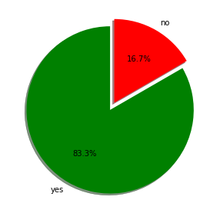
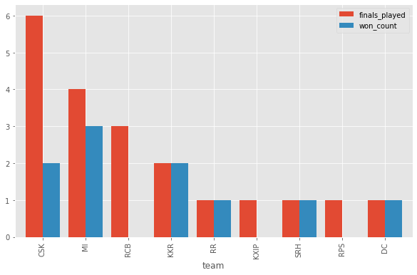
Results
Bar graph says that CSK played most number of finals and MI becomes most of the times champion.
And pie chart shows how important toss winning in finals. Pie chart shows 83.3% chance to win final if you win the toss.

Slide 12
Recommendation
After winning the toss what to choose bat or field and by that we can predict which team will win and predict champion in finals.
During auction, this analysis could be helpful for team management by seeing most successful batsman and bowler.
And captain get an idea to choose a bat or bowl first by seeing their performance they are good at chase or defend.

Slide 13
Conclusion
There should be players experience so during auction team management get an idea to bid on player but here I created graph for most successful batsman and bowler by that owner get to know performance of players and get an idea to put bid on player and buy them during auction.

Slide 14

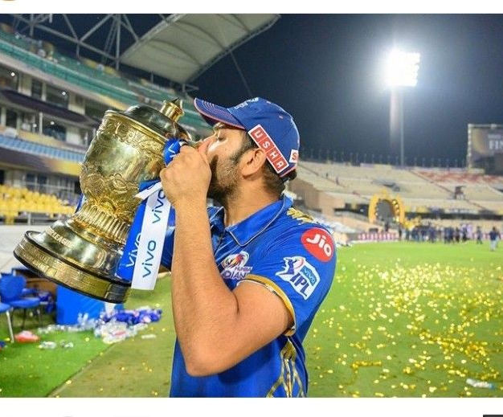

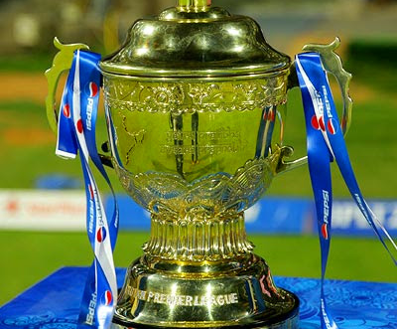
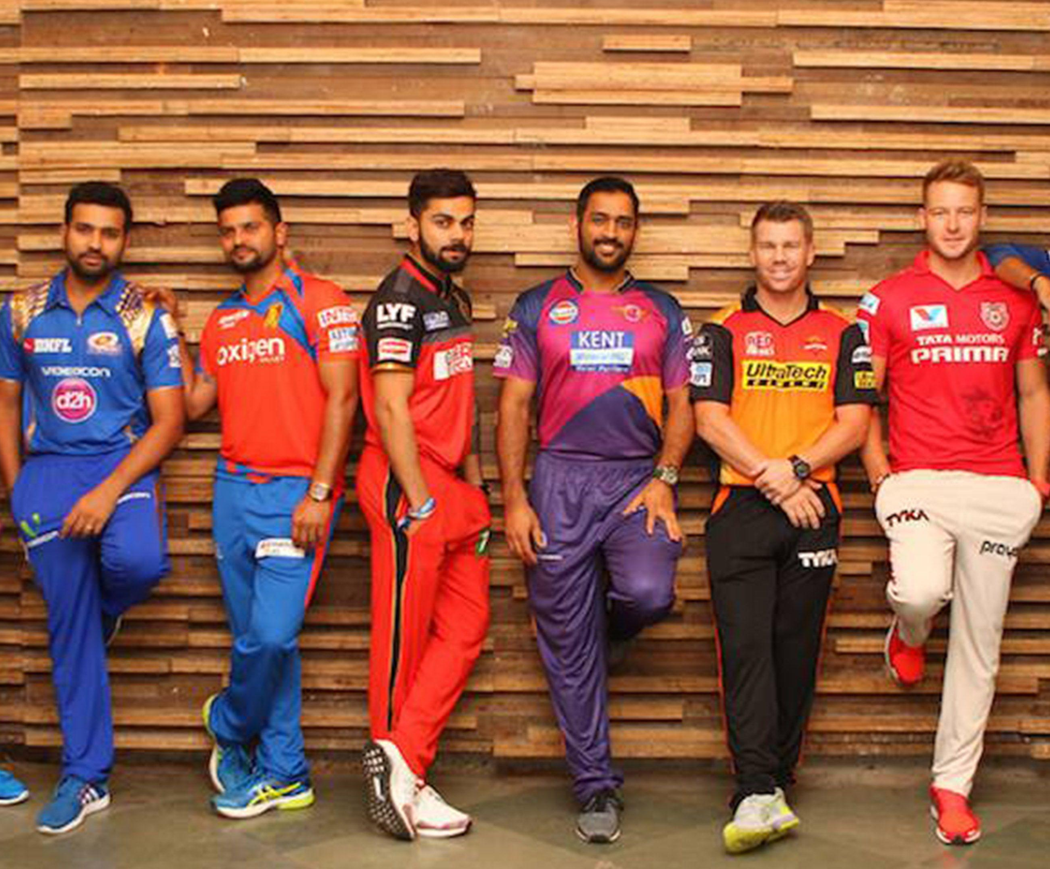
Thank you
Krishna Solanki

